Slide 1

Garage application (بسطَة) CS 410T 6C7
Done By:
Reem AlRashed.
Duna AlZunaytan.
Nada Alharbi.
Melaf AlHeejelan.
Shroug AlThubaiti.
Under the supervision of:
L. Rawan.

Slide 2
Introduction:
Due to the absence of support for the reuse idea, waste is typically discarded or burned directly, resulting in pollution in the environment . Trash creates pollution, and that is damaging to people, wildlife as well as the atmosphere.
Hence, a garage store is going to be implemented on the android operating system. It intends to encourage the idea of reusing products, by providing a user-friendly store application.

Slide 3
System limitations:
Users: Admin and Customer.
Language: Arabic.
Operating System: Android.

Slide 4
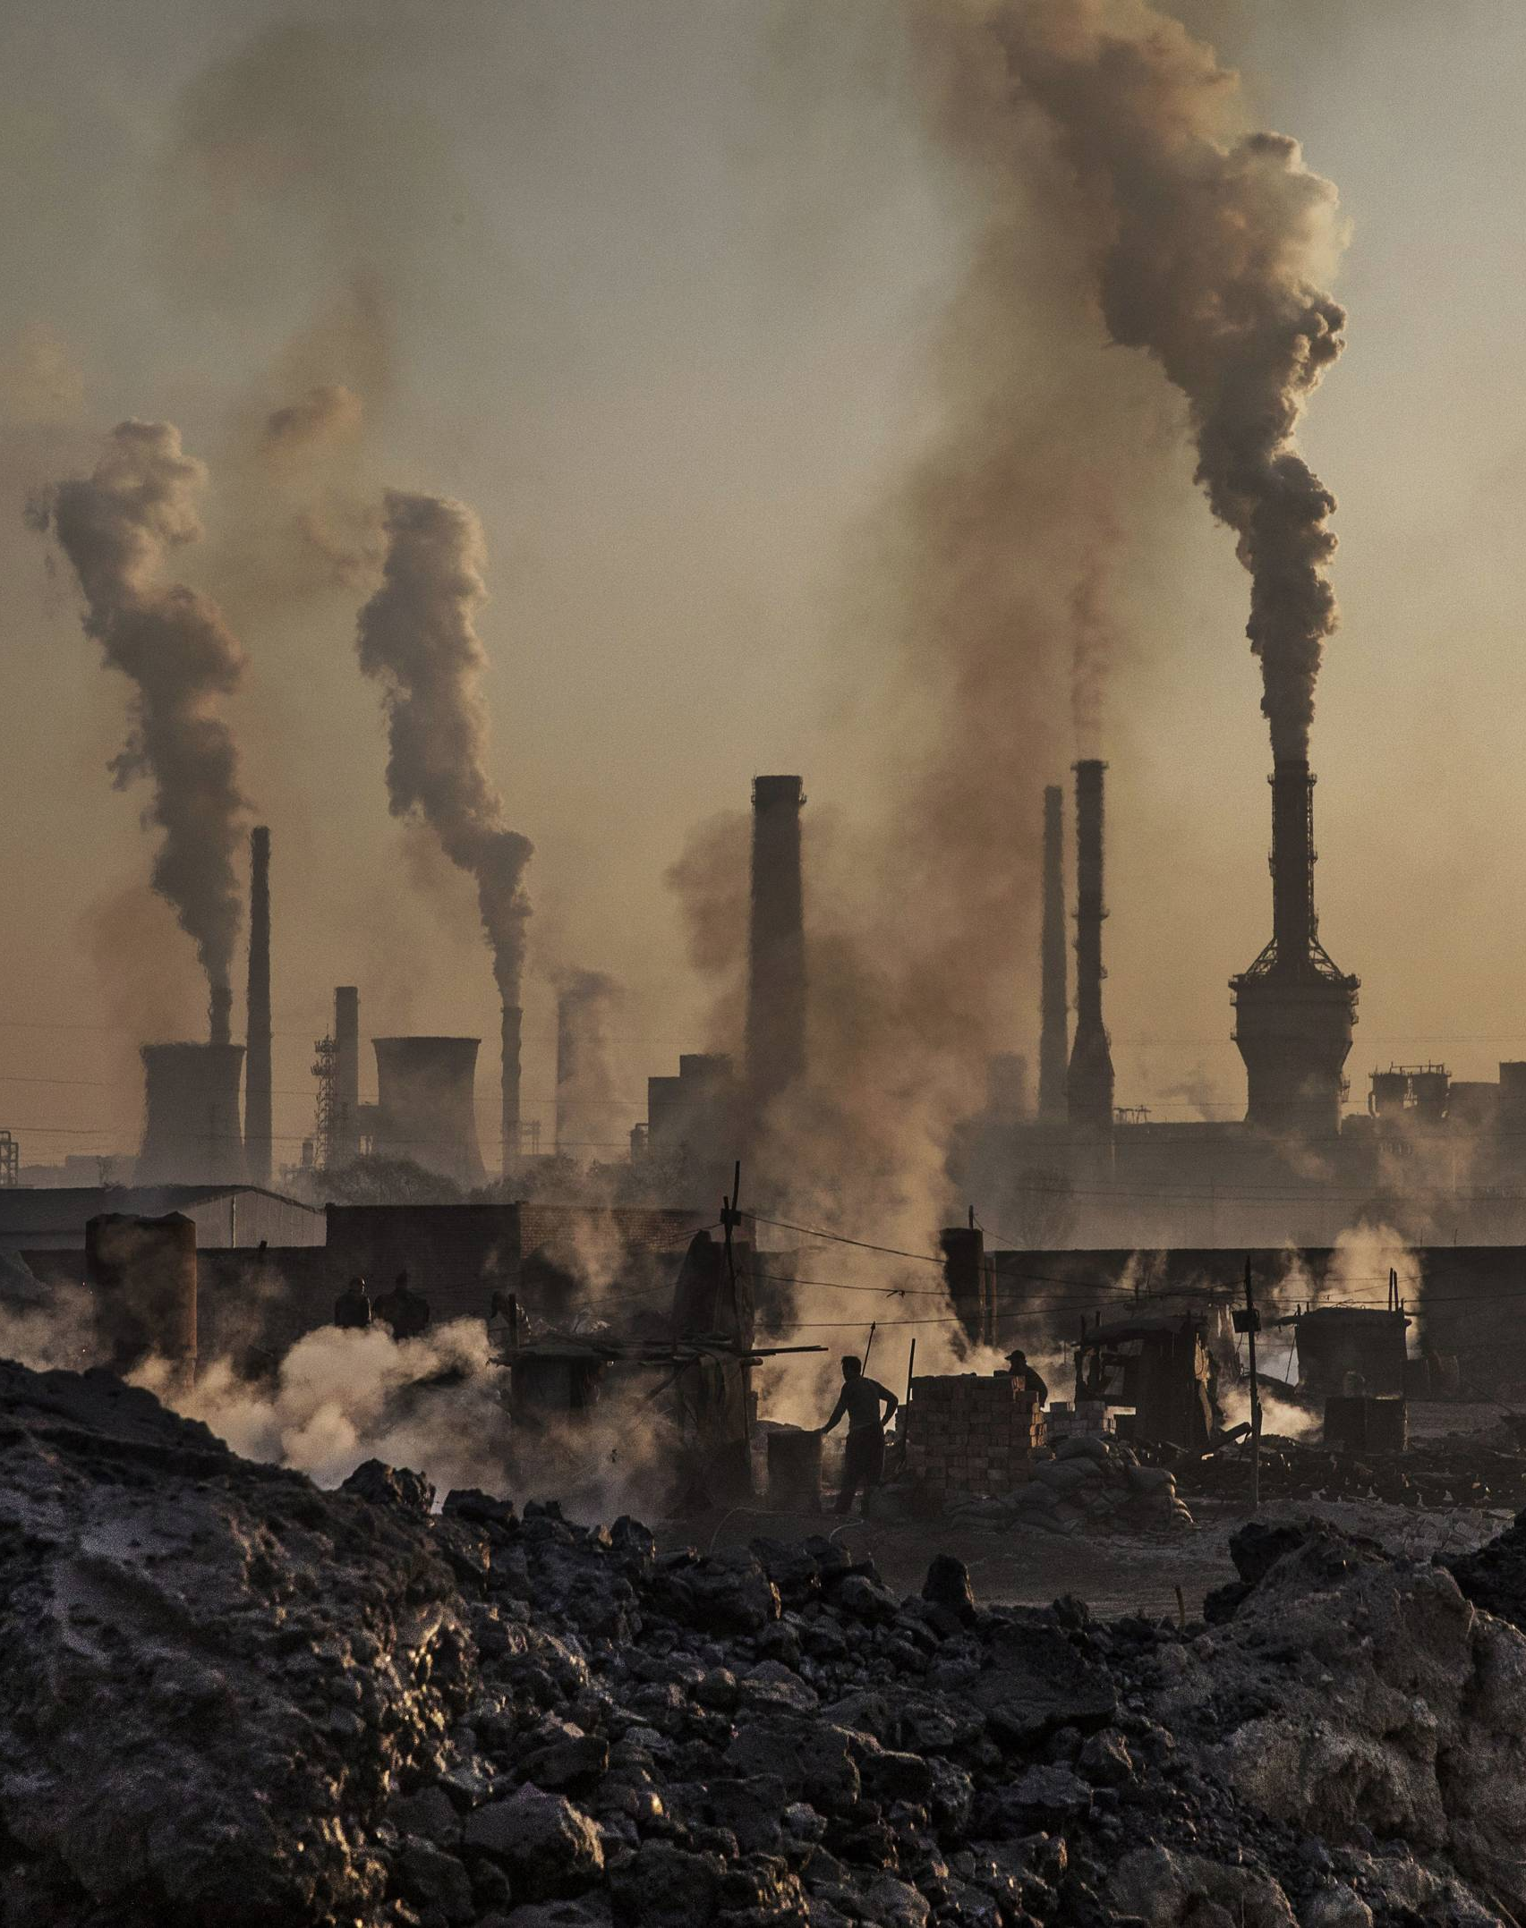
Pollution :
Pollution is the adding to the atmosphere of any material (solid, liquid, or gas) or any source of energy at a rate higher than it could be spread, filtered, broken down, reused, or stored in any harmless way.
Air, water, and land pollution are the main kinds of pollution. All forms of pollution have negative effects on the environment and wildlife, which also impair human safety and well-being .

Slide 5
Pollution causes :
Bacteria, insects and vermin thrive from garbage.
Overflowing waste causes air pollution and respiratory diseases.
Garbage contaminates surface waters, which affects all ecosystems.
Direct handling of overflowing waste exposes for health risks.

Slide 6
Types of pollution :
Air pollution.
Water pollution.
Land & Soil Pollution.

Slide 7

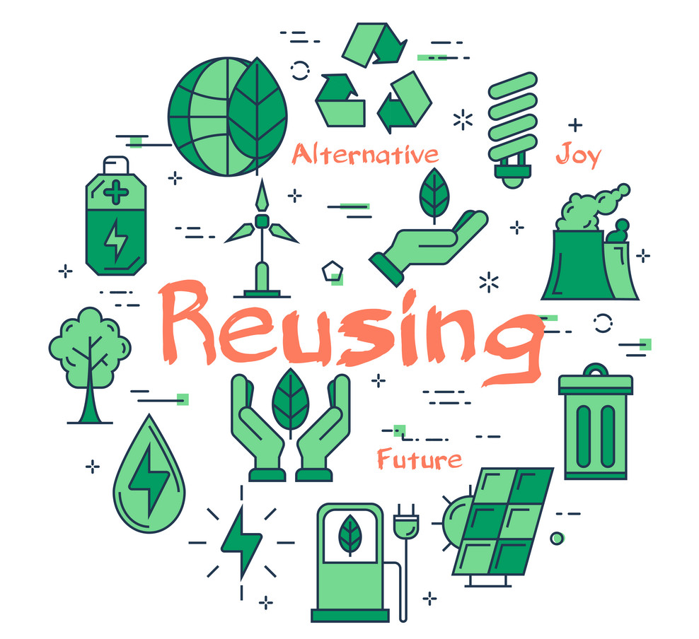
Re-using :
Reuse involves using something again instead of throwing it in away.
Normally, this implies seeking new usage.
Reuse saves the resources and raw materials used to manufacture new goods, saving money and the volume of waste.

Slide 8

How to Reuse:
Buy used items.
Look for products that use less packaging.
Buy reusable items. For example, you can bring your own silverware and cup to work.
Rent or sell items that are used infrequently, like decorations, tools or furniture.

Slide 9
Buying and selling used products benefits:
Less expensive.
Don’t require energy to create.
Don't have packaging.
Support the local economy.

Slide 10
Proposed & Similar Systems Comparison:
 | Our system بسطَة | System (1) swapit | System (2) Haraj
Free | Fully | Partially | Fully
Users | Admin, customers | Customers | Customers
Domain | Online stores | Online stores. | Online stores.
Language | Arabic | English | Arabic
Sign in | Required | Required | Required
Selling and buying at the same time | Available | Available | Available
Add selling post | Unlimited | Unlimited | Unlimited
Products pictures | Unlimited | Limited | Unlimited
Region supported | Supports any place | Only nearby | Supports any place
Chat | Not available | Available | Not Available
Check out | Available | Not available | Not available

Slide 11
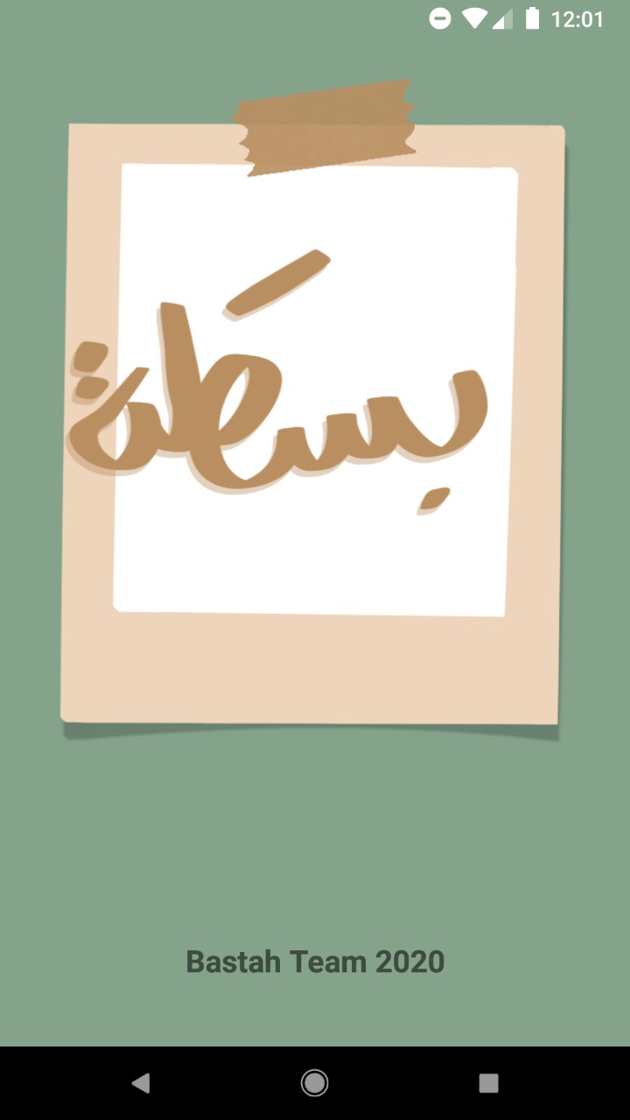
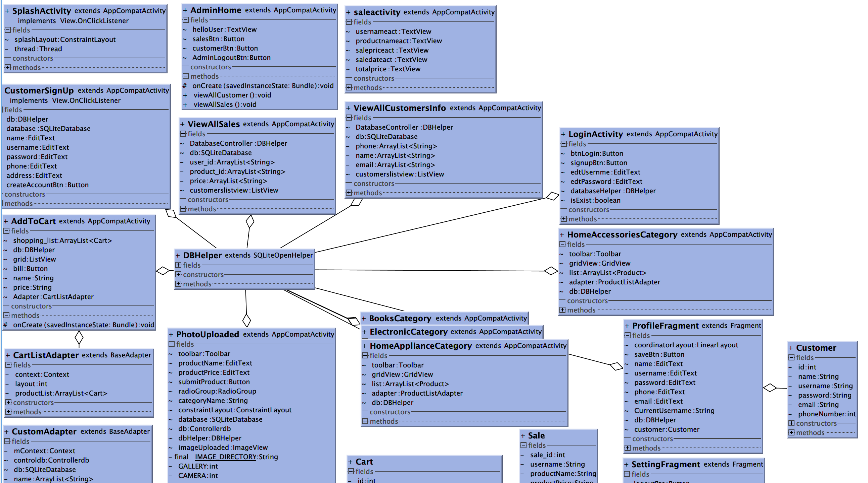
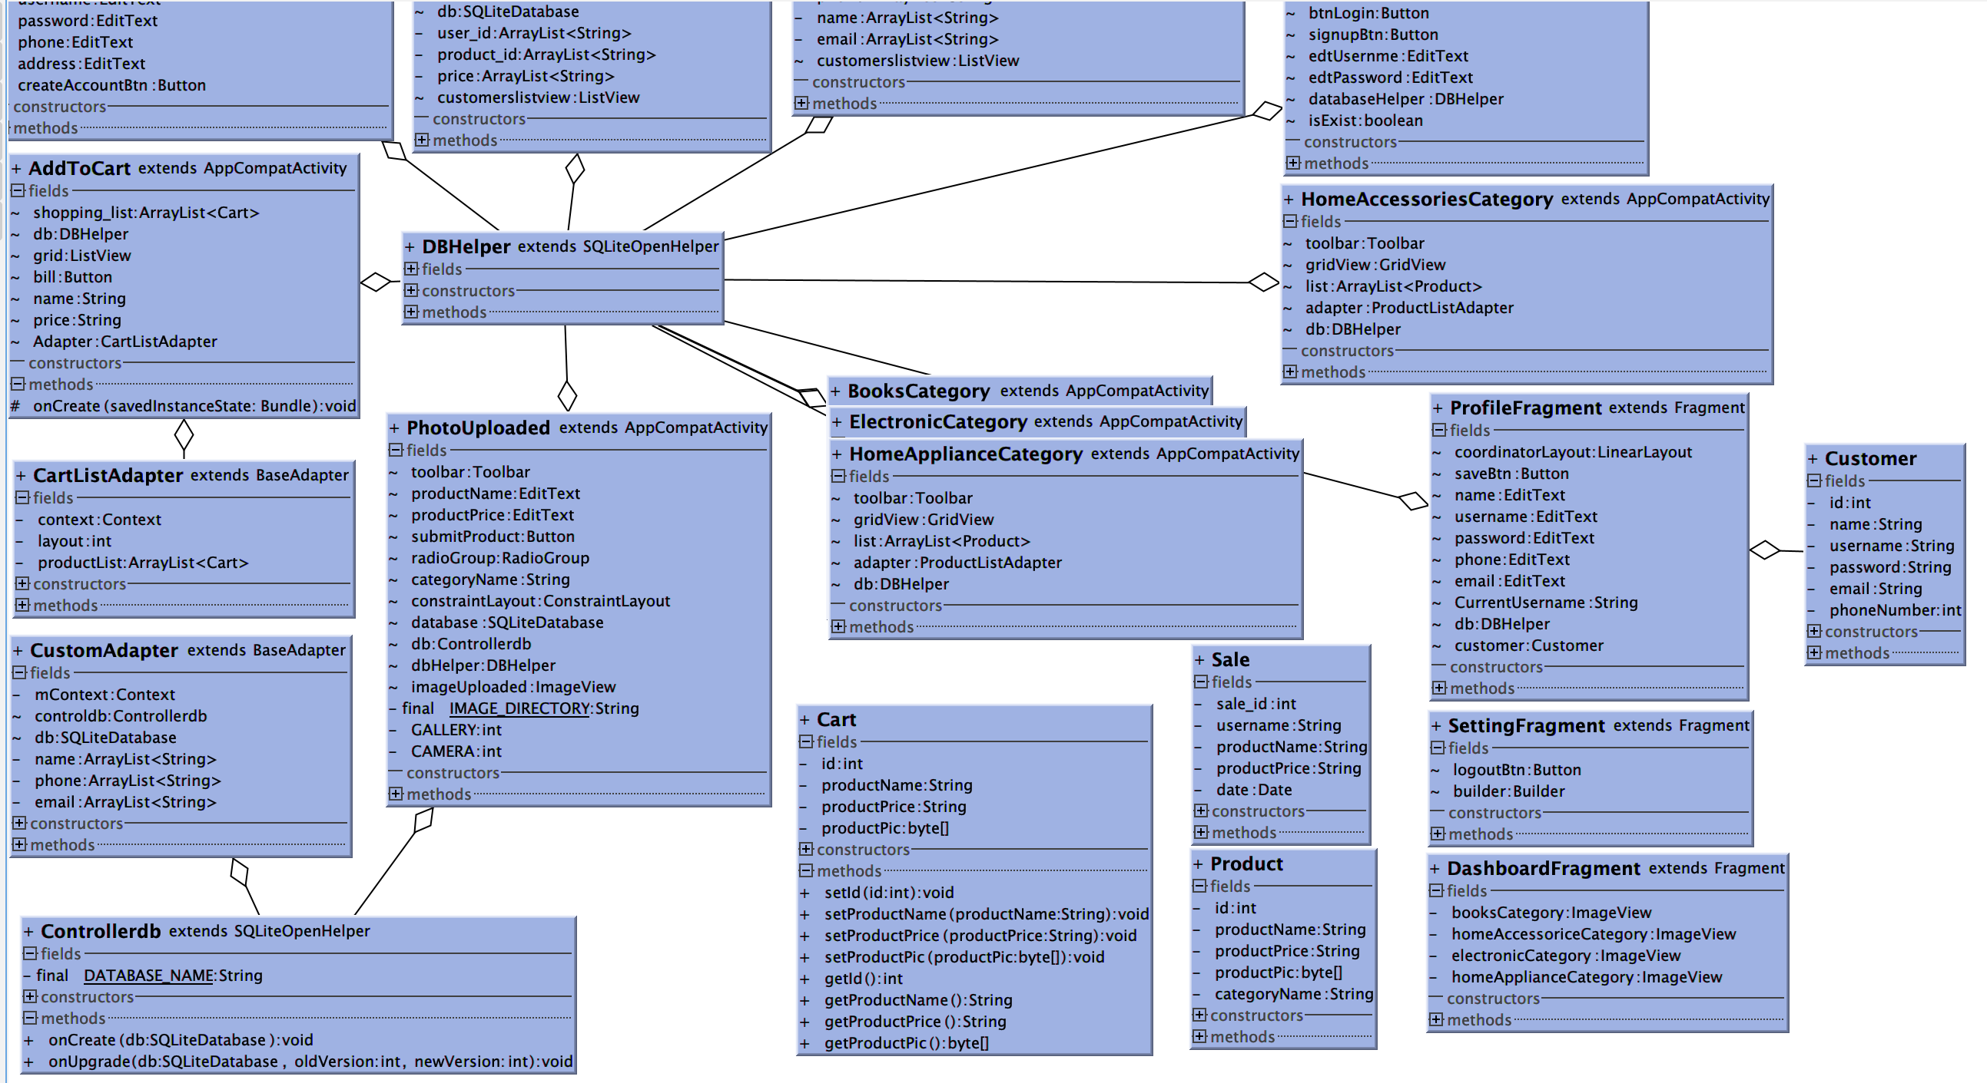
Class Diagram :

Slide 12
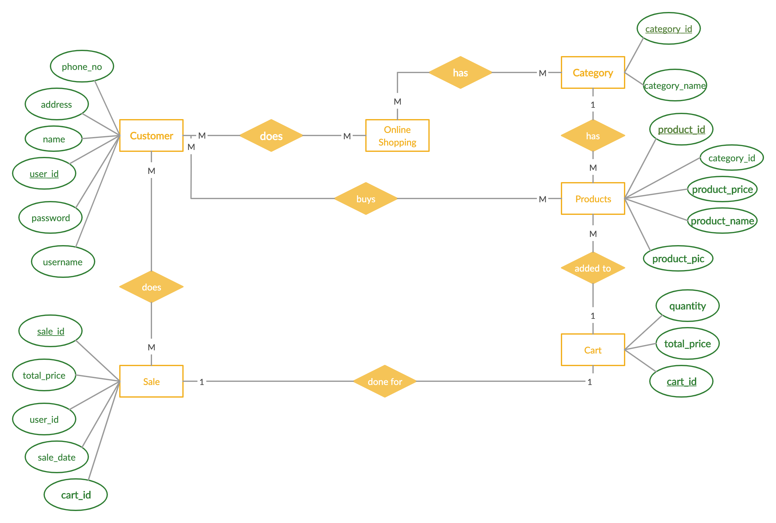
ER diagram:

Slide 13

Implementation steps :
UI Design
Database
Java

Slide 14
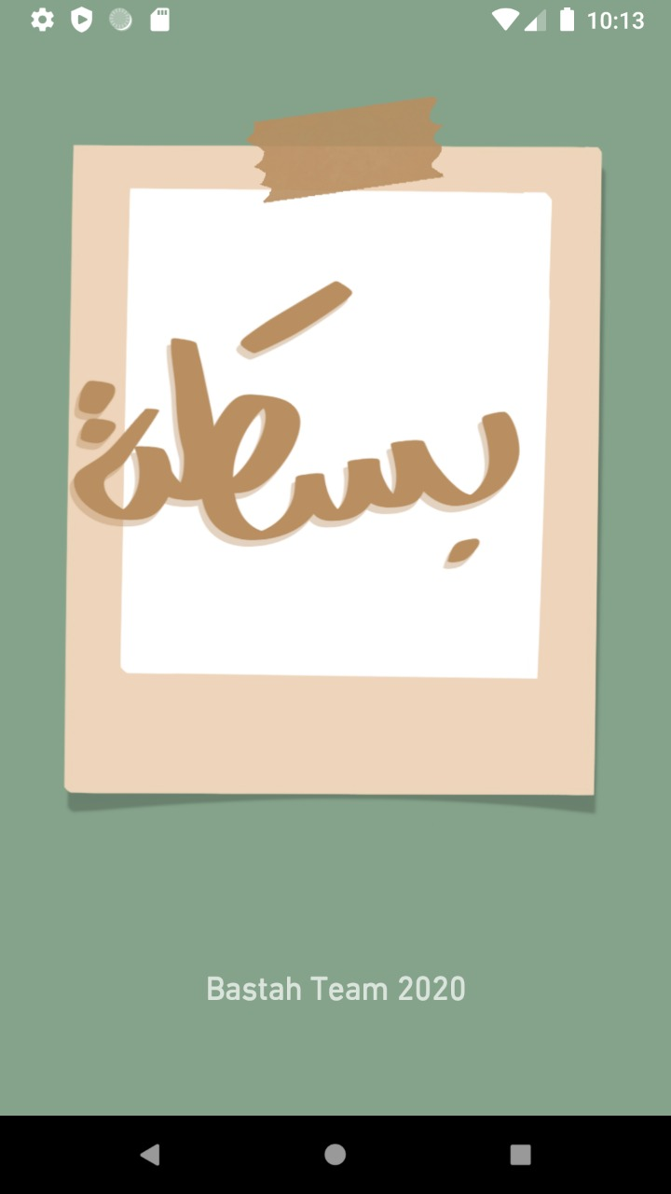
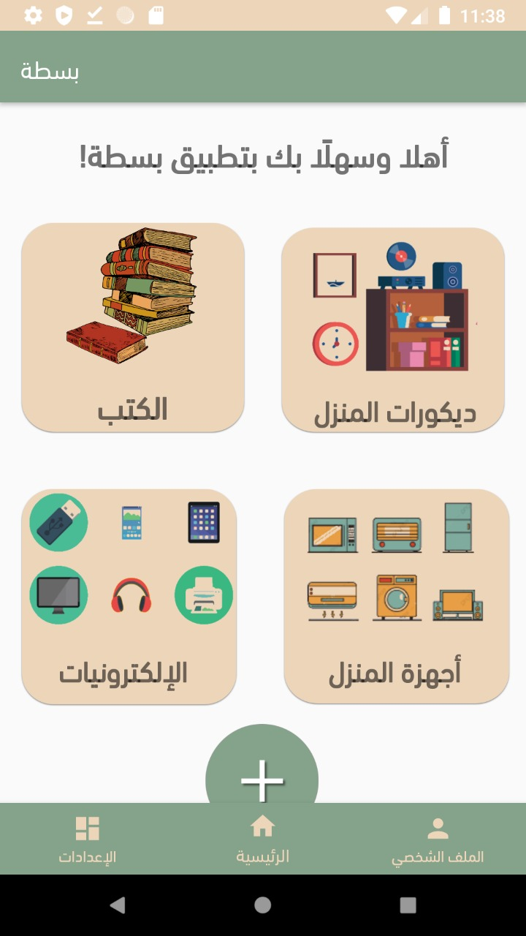
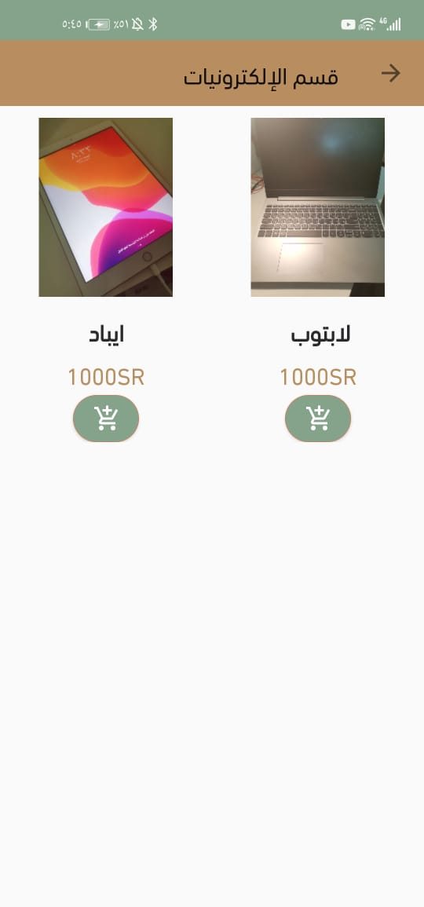
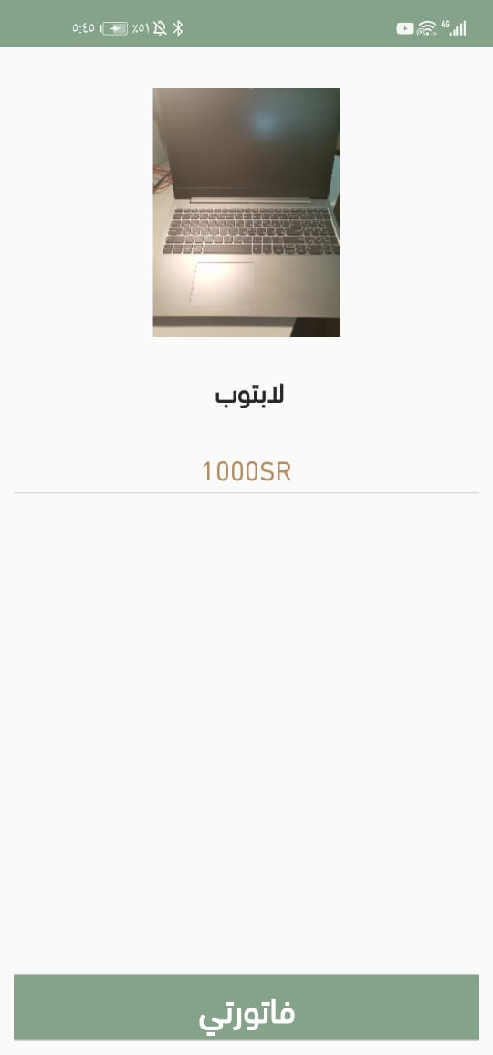
User Interfaces:

Slide 15
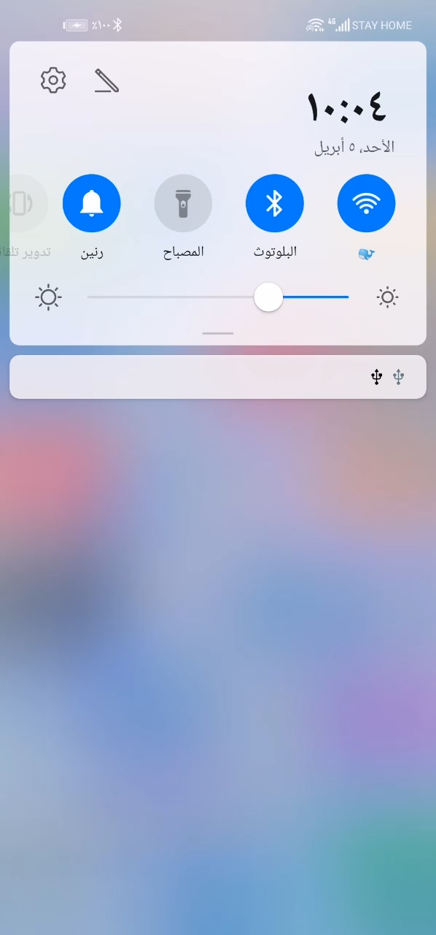
Run demo:
The run on actual android device

Slide 16

Conclusion:
In the design phase, we took into consideration that all ages should be benefited from (بسطة) application, so the design was simple, clear and comforts the eyes.
So, we conclude that we have a user-friendly application which System allows customers to sell their unneeded used products and buy things they need from other customers as well.
Choosing the store application is confusing for users and challenging for mobile applications developers, offering such as (بسطة) application with our native language will be such an advantage.

Slide 17



Future work:
Add chatting capability.
Translate the application to more languages.

Slide 18
And that’s it, Thank you.
Garage application team (بسطَة) CS 410T

